Slide 1
LoRa Tracking

Slide 2

Session Aims
To understand how telemetry data is transmitted using LoRa-wan (Long Range - Wide area network)
To receive LoRa telemetry from you payload
You will need (per pair):
1 x payload (per room)
1 x lapdock (each)
1 x Raspberry Pi B+
LoRa Board
SD card (blue)
Magnetic mount aerial

Slide 3

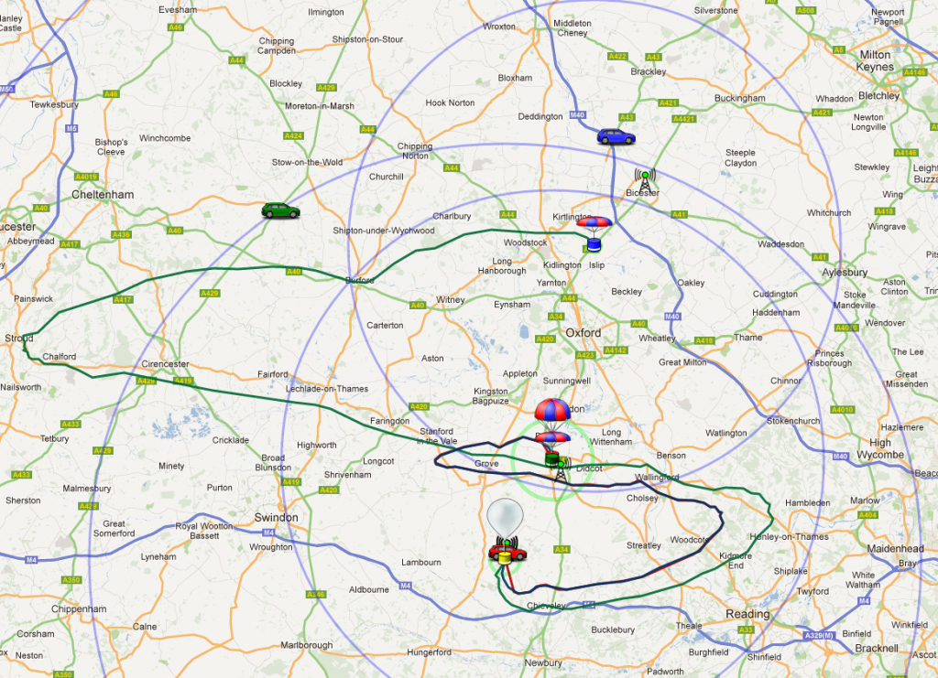

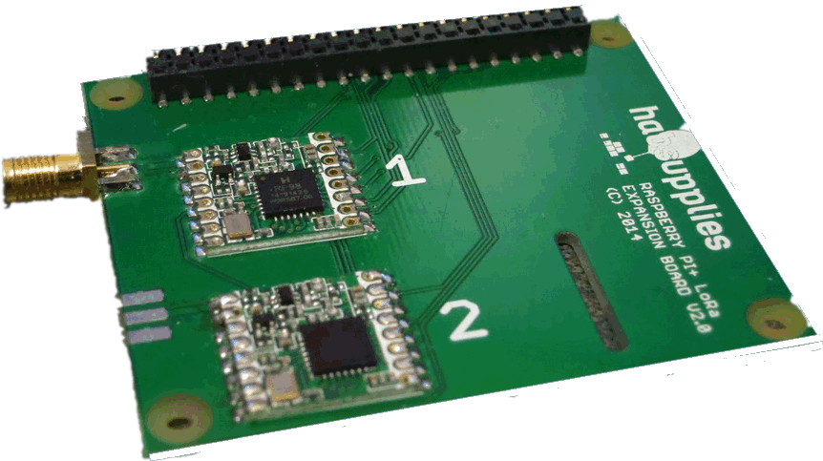
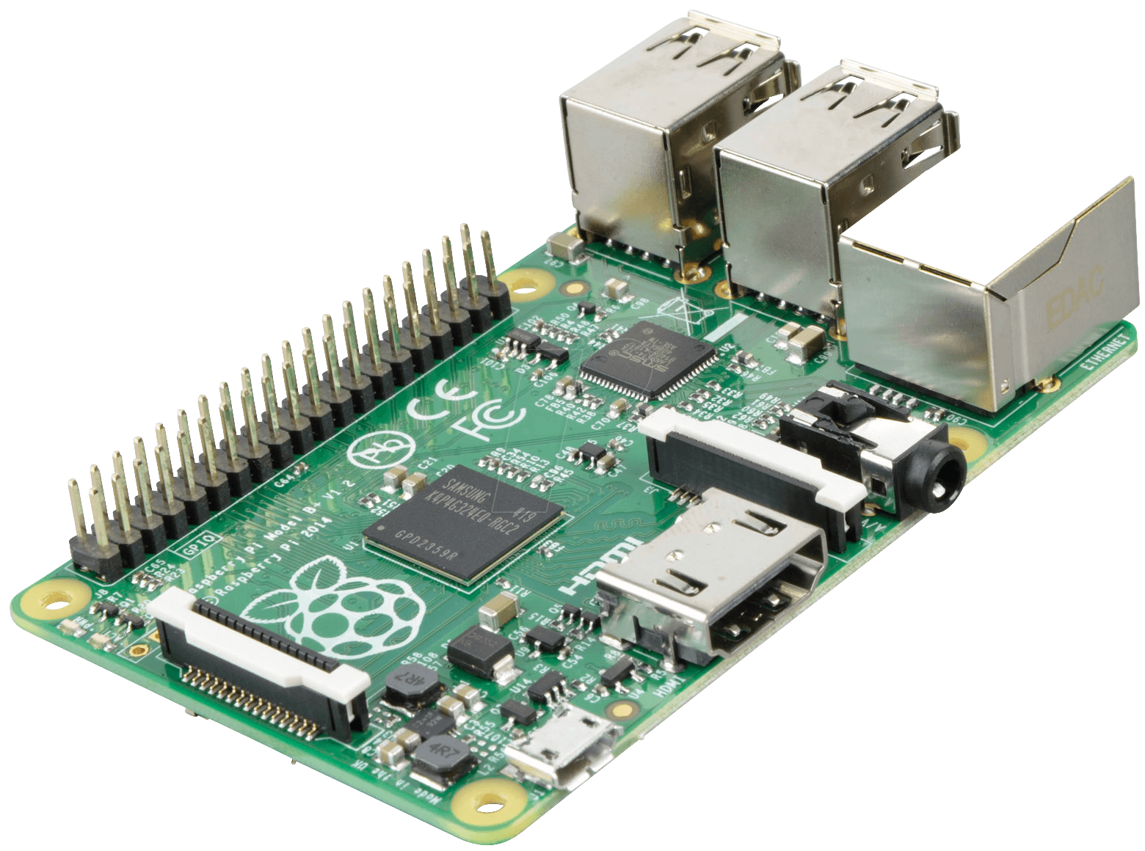
Distributed Tracking - LoRa

Slide 4
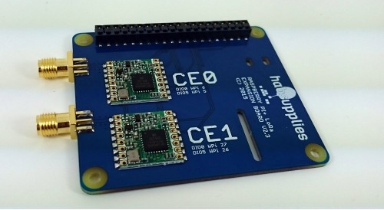
LoRa - Long Range Radio

Slide 5
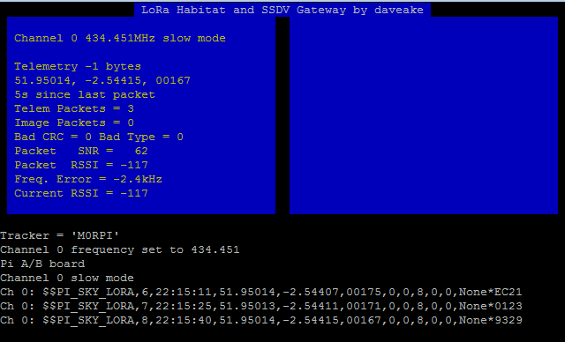
LoRa Gateway

Slide 6
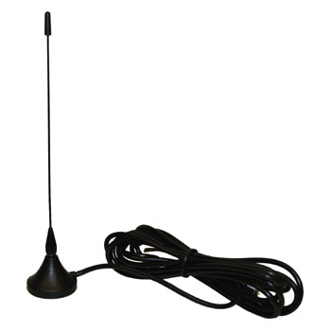
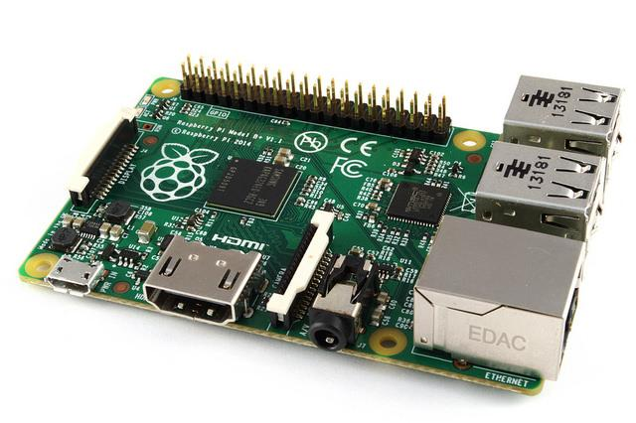
Assembly
Connect your LoRa board to your Raspberry Pi B+
Insert your SD card
Connect your aerial via the adapter to the LoRa Board
Connect your Pi to a lapdock, boot it and long in

Slide 7
SD Card Build
Always begin with the most up to date Raspbian SD card you can find.
Login with username pi and password raspberry
Ensure your card is up to date using commands:
sudo apt-get update [enter]
sudo apt-get upgrade [enter]
Next enter the configuration menu by typing:
sudo raspi-config [enter]

Slide 8
SD Card Build
From raspi-config:
Expand Filesystem
Advanced Options --> SPI → Yes → Ok → Yes → Ok
Advanced Options --> Serial → No → Ok
Advanced Options → Device Tree → No → Ok
Select Finish → Yes
A reboot may be required

Slide 9
Wiring Pi
cp -R .skycademy_downloads/* .
The wiring pi software enables the Raspberry Pi to communicate with the PITS board, to install type:
cd wiringPi
./build
cd /home/pi
rm -rf pits

Slide 10
SSDV
The SSDV software enables the pits board to encode images to be transmitted over radio waves
cd /home/pi
cd ssdv
sudo make install

Slide 11
LoRa gateway software
The gateway software receives telemetry data from the payload, displays it and publishes it to the web
cd /home/pi
cd lora-gateway
Edit the configuration document:
nano gateway.txt

Slide 12
LoRa - Long Range Radio
tracker=M0RPI
EnableHabitat=Y
EnableSSDV=Y
LogTelemetry=N
CallingTimeout=60
frequency_1=434.450
mode_1=1
DIO0_1=6
DIO5_1=5
AFC_1=Y
First section identifies you, and enables upload of telemetry and images.
Final section sets up the frequency to listen on and the mode to use (you usually want mode = 1).
AFC is Automatic Frequency Control (keeps tuned in to transmitter)
DIO0_1= and DIO5= should match the numbers printed on your LoRa board.
Setup config file
To test press Ctrl + O to save and then Ctrl + X to exit
Then run :
sudo ./gateway

Slide 13
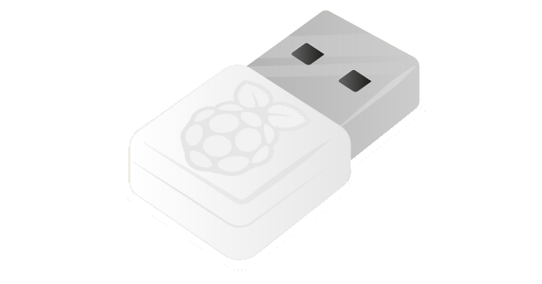
Setup up wireless
In order to broadcast you will need to connect your Raspberry Pi to a wifi hotspot.
From the terminal type:
sudo nano /etc/wpa_supplicant/wpa_supplicant.conf
Remove sections that don’t apply to your wifi hotspot
Use Ctrl + O and Ctrl + X to save and exit.
Connect a Wifi dongle and test

Slide 14
Auto starting gateway software
Your Pi will be operating headlessly during flight so you will need to ensure the software is running when the Pi loads.
For this we need to edit a config file
From the terminal type:
sudo nano /etc/rc.local
Above the line that says exit 0 add:
cd /home/pi/lora-gateway
sudo ./gateway&
Use Ctrl + O and Ctrl + X to save and exit.
Reboot

Slide 15
